Slide 1


Veri Bilimi Bootcamp’i 7. Hafta
www.CarbonConsulting.com info@carbonconsulting.com @ Meysam Asgari-Chenaghlu & Salih Talha Akgün

Slide 2
Computer Vision Nedir?
01
TABLE OF CONTENTS
Kodlama
03
Soru&Cevap
04
Computer Vision üzerine konuşalım.
Convolutional Neural Networks
02
CNN nedir? Nasıl çalışır?
Image processing ve Computer Vision için kodlamalar.

Slide 3
01
Computer Vision Nedir?

Slide 4



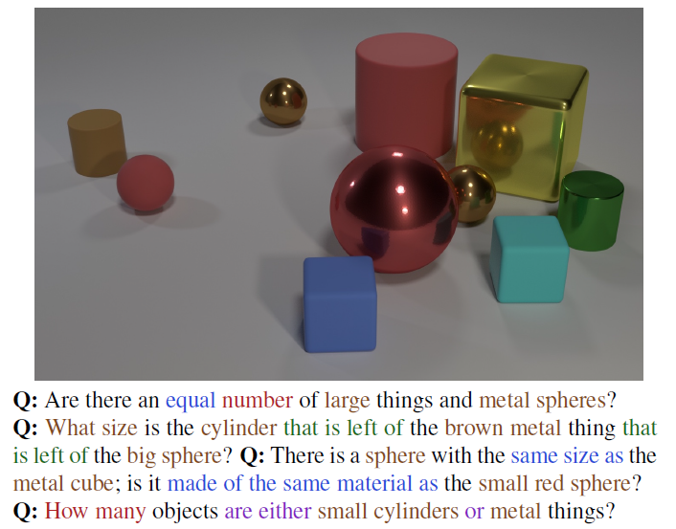
Computer Vision

Slide 5
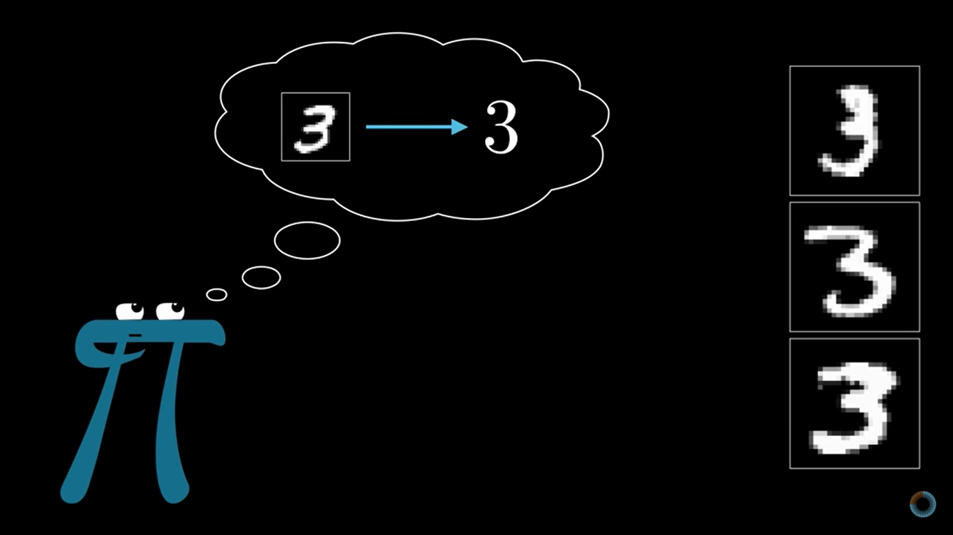
Computer Vision
https://youtu.be/GVsUOuSjvcg?t=221

Slide 6
Image Processing | Computer Vision
Focused on processing the raw input images to enhance them or preparing them to do other tasks | Focused on extracting information from the input images or videos to have a proper understanding of them to predict the visual input like human brain.
Image Processing is a subset of Computer Vision. | Computer Vision is a superset of Image Processing.
Rescaling image (Digital Zoom), Correcting illumination, Changing tones etc. | Object detection, Face detection, Hand writing recognition etc.

Slide 7

Object Detection
https://bair.berkeley.edu/blog/2019/03/27/cvpr-competition/

Slide 8
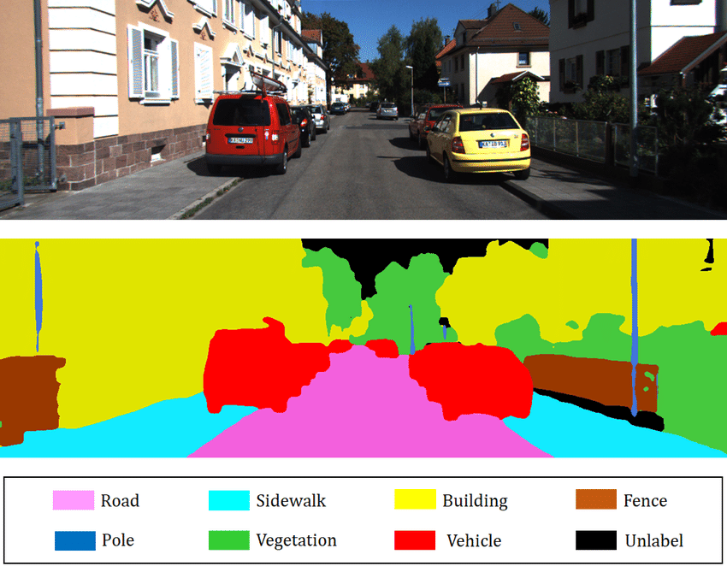
Image Segmentation
https://www.youtube.com/watch?v=qWl9idsCuLQ

Slide 9
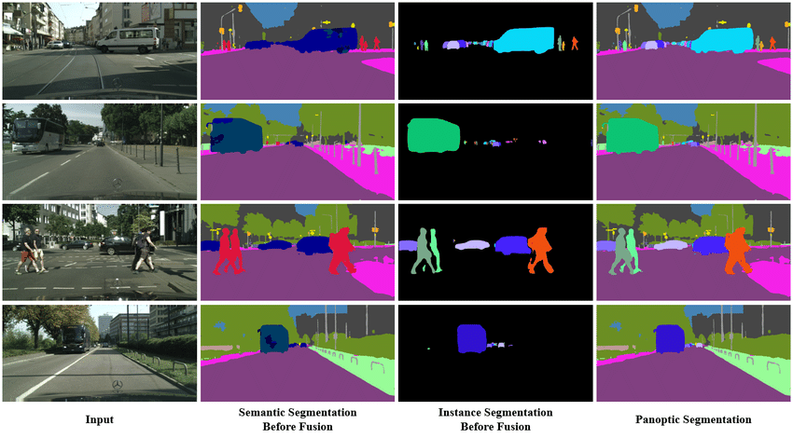
Semantic – Instance – Panoptic Segmentation

Slide 10
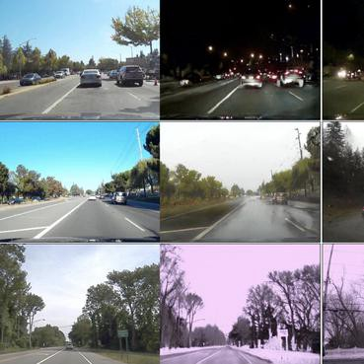
Domain Adaptation

Slide 11
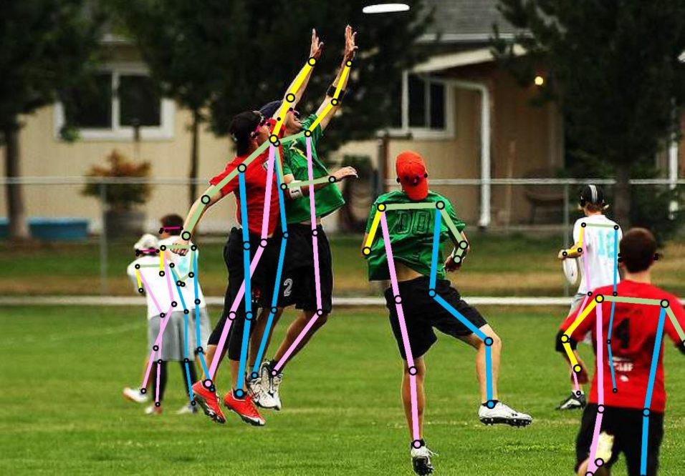
Pose Estimation

Slide 12
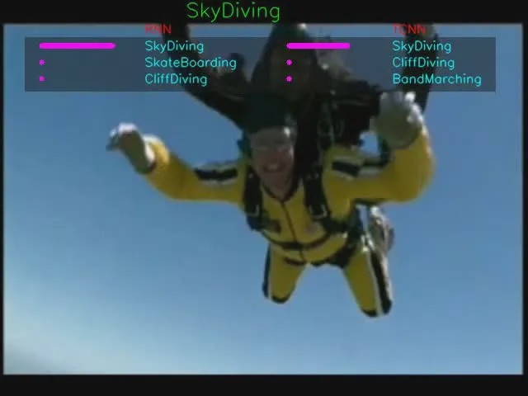
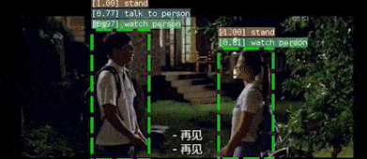
Action Classification
https://youtu.be/7_mcWCB76Ps?t=266

Slide 13
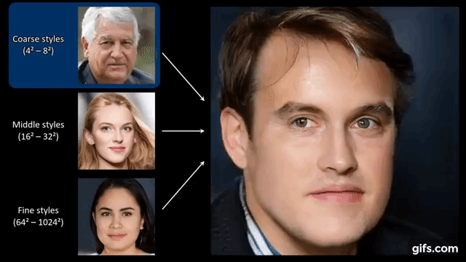
Image Generation
https://www.independent.co.uk/tech/facebook-deepfake-ukraine-zelensky-russia-b2037766.html

Slide 14
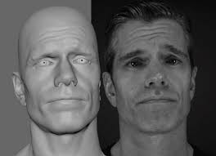
3D Face Animation
https://www.youtube.com/watch?v=kNOBWQOD-og

Slide 15
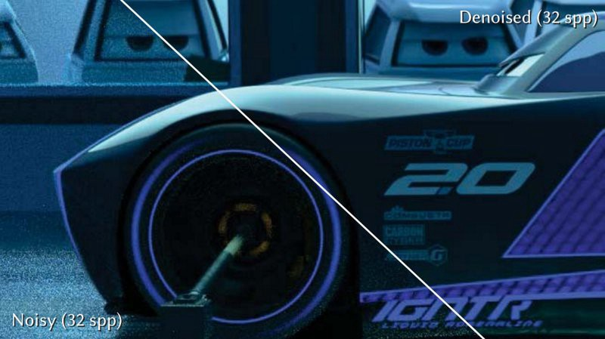
De-noising

Slide 16
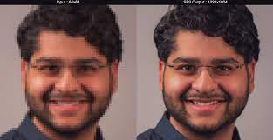
Super-Resolution

Slide 17
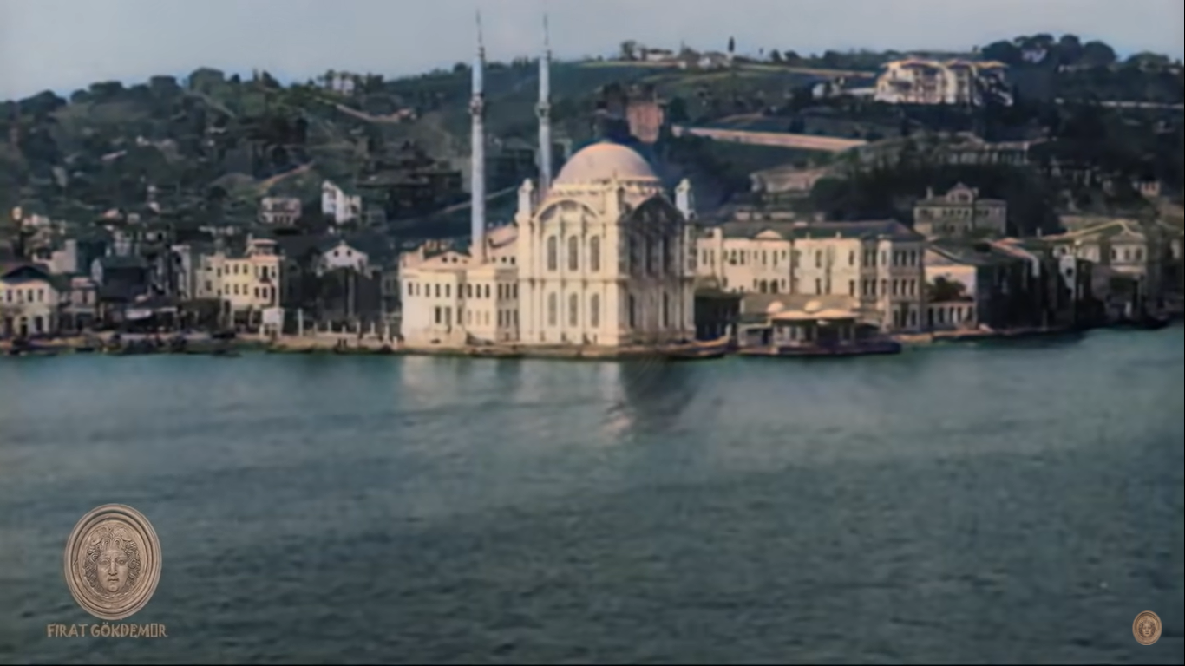
Re-coloring
https://www.youtube.com/watch?v=Pejti3plPAg

Slide 18
02
CNN Nedir?

Slide 19


Convolution
https://www.youtube.com/watch?v=ArPaAX_PhIs&list=PLkDaE6sCZn6Gl29AoE31iwdVwSG-KnDzF
16x16 = 256
1000x1000x3 = 3M
256x1024 = 262K
3M x 1000 = 3B

Slide 20
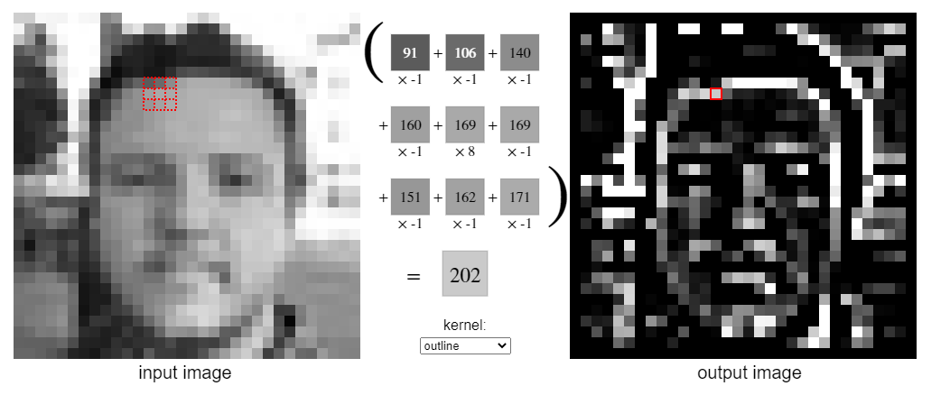
Convolution
https://setosa.io/ev/image-kernels/

Slide 21
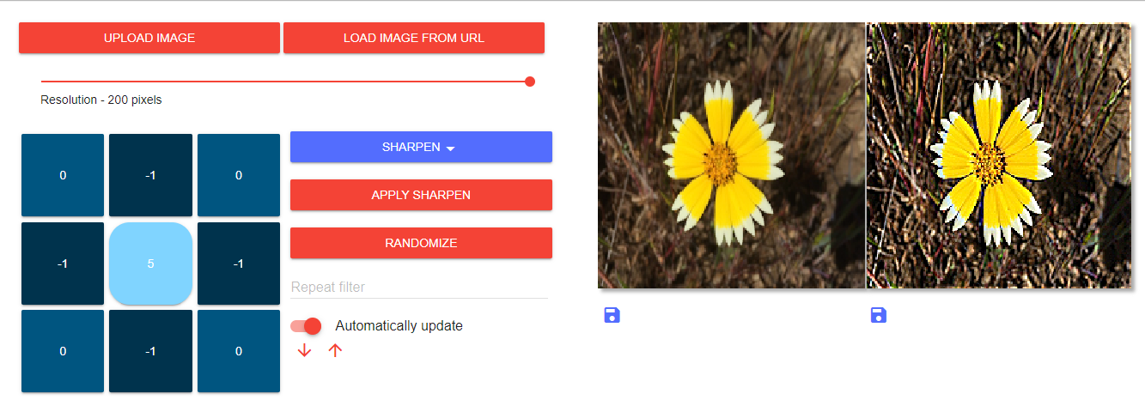
Convolution
https://generic-github-user.github.io/Image-Convolution-Playground/src/

Slide 22
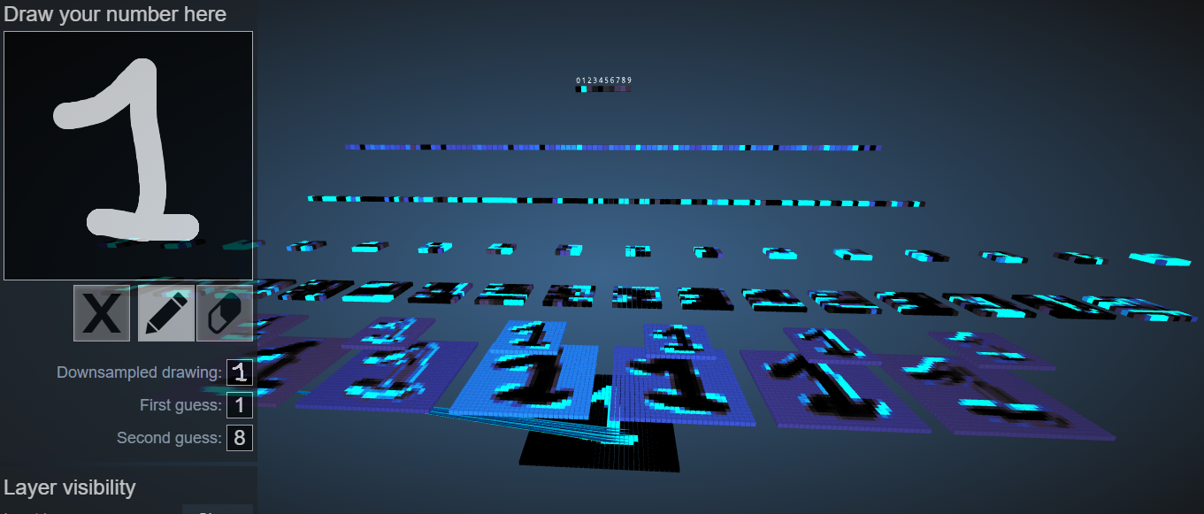
CNN
https://poloclub.github.io/cnn-explainer/

Slide 23
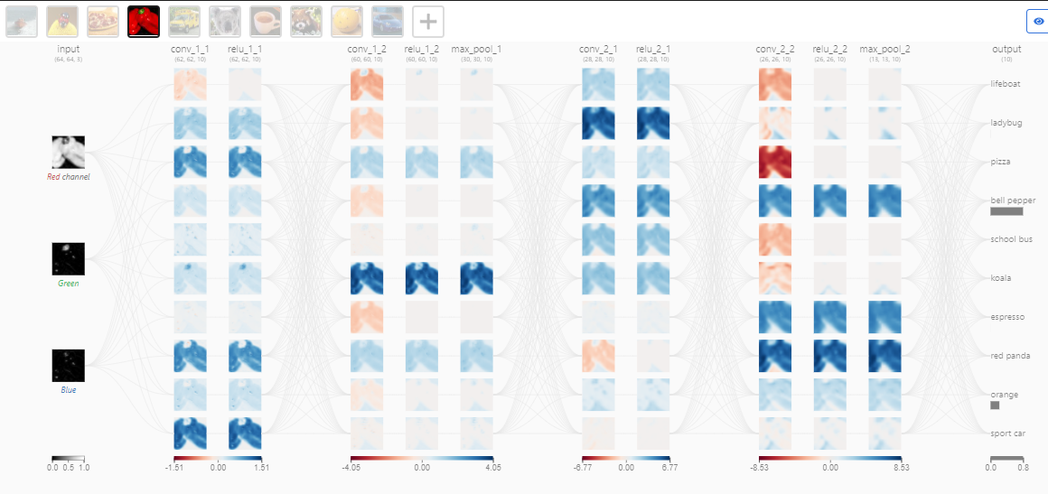
CNN
https://poloclub.github.io/cnn-explainer/

Slide 24
03
Kodlama

Slide 25

Birlikte #Kodluyoruz

Slide 26
Soru & Cevap

Slide 27
Resources
https://towardsdev.com/10-interesting-computer-vision-tasks-3e5437a14668
https://www.v7labs.com/blog/computer-vision-applications
https://analyticsindiamag.com/semantic-vs-instance-vs-panoptic-which-image-segmentation-technique-to-choose/
https://medium.com/@CharlesOllion/whats-easy-hard-in-ai-computer-vision-these-days-e7679b9f7db7
https://paperswithcode.com/area/computer-vision
https://pyimagesearch.com/
https://github.com/lmoroney/mlday-tokyo
https://www.sainingxie.com/Tutorials/CVPR2020/index.htm

Slide 28
Teşekkürler
carbonconsulting.com

